Slide 1


Slide 2
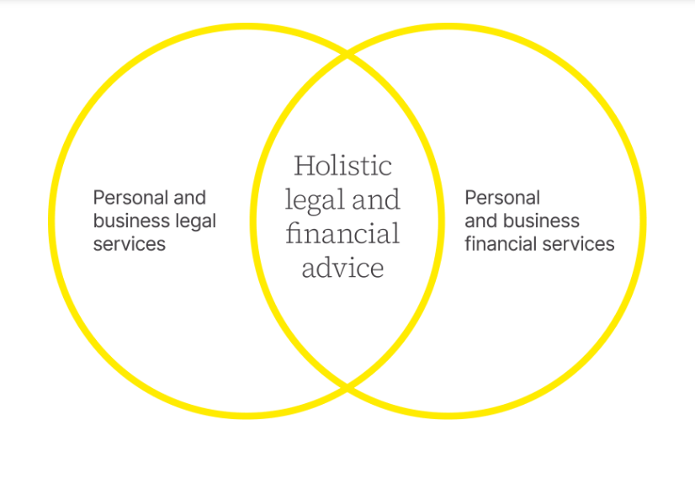
Welcome and Update
22 January 2026

Slide 3
Agenda
14:00: Welcome
14:15: Case Management, by Tula
15:15: Break
15:30: ‘Payments for Accommodation purchases’, Ben Collins KC and Carl Rix
16:15: Professional Values
17:30: Meeting Closes
17:30-18:30 Drinks with Old Square Chambers Clerks and Barristers

Slide 4
Department Update Finance, People, Workflow & Strategy

Slide 5
Revenue Performance End P3 (£m)
Fee income: £3.22m after WiP adjustment (c. £350k)
£362,907 (10.1%) below budget
25.1% year-on-year growth from £2.58m
Partner billing: 16% of total billings - Well above 8% budget

Slide 6
Utilisation & Efficiency
Utilisation: 101% vs 100% budget
Time recorded: £3.74m (9% YoY growth)
Realisation reduced to 89% following major write-off (Chapman)

Slide 7
Capacity Across the Department
24.2 fee earner FTEs plus 2 trainees
Effective capacity reduced due to maternity leave and apprenticeships
Average revenue per adviser: £124.5k vs £153k budget

Slide 8
Improvement in Working Capital
Debtor days reduced to 9 days from 26
Work in progress reduced to 545 days
WIP remains elevated with significant unbilled value

Slide 9
Profitability
Direct costs: £1.36m (£7k under budget)
Gross margin: £1.86m (58%)
Significant improvement from 50% a this point last year

Slide 10



Q4 Finances – Looking forwards
FY 2025-2026 budget £4.510m
Challenge is to find £1.29m Q4
FY2024-2025 we found £2m in Q4
We have £7.2m WiP in the bank

Slide 11
Workflow
47 new matters opened (down from 94)
? change reflects use of new opportunities
The medical, legal and procedural complexity and volume of work (if not matters) has increased notably

Slide 12


People & Culture
Movers:
Alison Hills
Arjun Basra
Shakers:
Toni Adewole, Paralegal (Cambridge)
Annabel Harper Paralegal (Cambridge)
Johanne Turner, Senior Associate (Chelmsford)
Laura Robertson-Hayes, Senior Associate (Bishops Stortford)
Increased case complexity across the department
Current utilisation at 111%
“Busy is not the same as stressed.”
High-quality work maintained

Slide 13
Strategy & Forward Focus
Laser focus on case resolution
Management structure review ongoing
Exploring AI to improve efficiency
Transition to specialism-based supervision model
Converting recognised WiP to cash

Slide 14

The Obligation of Case Managers to Explore Statutory Funding
Angeline Jackson & David Fassioms

Slide 15

Why should case managers explore statutory funding?

Slide 16
Case Management Society UK (CMSUK)
“…a collaborative process of assessing, planning, implementing, coordinating, monitoring, and evaluating options/services to meet an individual's complex health, social care, educational, and employment needs, aiming for quality, cost-effective outcomes through communication and available resources.”
(CMSUK)

Slide 17
British Association of Brain Injury and Complex Case Management (BABICM)
“Case Management is a collaborative process which assesses, plans, implements, coordinates, monitors, and evaluates the options and services required to meet an individual’s health, wellbeing, social care, education and/or occupational needs, using communication and available resources to promote quality, cost-effective and safe outcomes.”
(BABICM)

Slide 18
Institute of Registered Case Managers (IRCM)
“[Case Managers] identify resources, supports, barriers, risks, and opportunities to facilitate successful outcomes, with due regard to value for money of any intervention.”
“Seek to ensure that resources available are used effectively and work within a given budget, were relevant to the service context.”
(IRCM)

Slide 19
Continuing Healthcare (CHC) / Integrated Care Board (ICB)
NHS Continuing Healthcare (CHC) is a package of care provided outside of hospital. It is arranged and funded by Integrated Care Boards (ICB) for people aged 18 years and over who have significant ongoing healthcare needs and have been assessed as having a ‘primary health need’.
People who are assessed for CHC include those who need a very high level of support. Some people may be reaching the end of their lives or have long-term conditions. When someone is assessed as eligible for CHC, their local ICB is responsible for funding their full package of health and social care.
Notes:
This means that the ICB will find suitable care to meet someone’s assessed needs.
The ICB will always try to meet the patient and family’s preference for the type and place of care provided and where possible will give options and choices that best match what people and their carers want.
There is a national framework which states that eligibility should be based on someone’s healthcare needs and not their diagnosis. It is not linked to savings or income.

Slide 20
Continuing Healthcare (CHC) / Integrated Care Board (ICB)
There is a national framework which states that eligibility should be based on someone’s healthcare needs and not their diagnosis. It is not linked to savings or income.
Notes:
Many people who are assessed for CHC are reaching the end of their lives or face a long-term condition, because of a disability, accident or illness. They can have a wide range of healthcare conditions and may receive funding for just a few weeks or many years.
People who may be assessed as eligible for CHC include:
People near the end of their lives.
They may have conditions like advanced cancer or heart disease or be a frail elderly person with a rapidly deteriorating condition and entering a terminal phase of their lives. Typically, people near the end of their lives will receive care for weeks or a few months.
Frail elderly people with complex physical or psychological needs. This could include frail elderly people with conditions such as dementia, weight loss, lack of mobility or Parkinson’s disease. Care can often be provided for several years.
People, aged 18 and over, with long term healthcare needs.
This could include people who have had an accident that has left them with long-term health care needs, such as spinal injury. It may also include people with long-term conditions such as multiple sclerosis. People will often receive care for many years and their eligibility for CHC may change as their needs change.
NHS CHC can be provided by the NHS in any setting, including a care home or at home.
If CHC is provided in a care home, it will cover the care home fees, including the cost of accommodation, personal care and healthcare costs.
If CHC is provided in the person’s home, it will cover personal care and healthcare costs.
Those in receipt of NHS CHC continue to be entitled to access to the full range of health services e.g. GP, hospital, outpatients, district nursing.
For most people, the assessment process involves an initial screening and then a full assessment. After the full assessment, a recommendation will be made to the ICB about whether the patient is eligible.
The initial screening is usually carried out by a health or social care professional who knows the person and uses a checklist to decide whether people need a full assessment. The person who completes the checklist will send it to the CHC team.
The full assessment is usually undertaken by a group of health and social care professionals who have been involved in the patient’s care. They are known as a multidisciplinary team (MDT).
The MDT will then make a recommendation to the ICB about whether the person is eligible, and the ICB will make the final decision.
Financial issues are not part of the decision about an individual’s eligibility for CHC. ICBs can, however, take account of comparative costs and value for money when arranging care and should ensure the services provided reflect the person’s preference as far as possible.
Health and social care professionals must use their professional judgement at both the screening and full assessment stages. They will consider the person’s combined healthcare needs across 11 domains (areas of need) to complete an initial checklist and across 12 domains to undertake the full assessment.
People will be assessed three months after their successful assessment and then annually. This is to ensure the care provided is still relevant and providing the right support, as well as ensuring that CHC is still needed.

Slide 21
Continuing Care / Integrated Care Systems (ICSs)
NHS continuing care is support provided for children and young people under 18 who need a tailored package of care because of their disability, an accident or illness. It is different from NHS continuing healthcare, which can be provided to adults who have very severe or complex health needs.
The main difference is that while continuing healthcare for adults focuses mainly on health and care needs, continuing care for a child or young person should also consider their physical, emotional and intellectual development as they move toward adulthood.

Slide 22
Continuing Care / Integrated Care Systems (ICSs)
This means that if a child is assessed for NHS continuing care, it is likely that a range of organisations will be involved, such as health, education and local authority children’s services. These different agencies will contribute to the child’s care package if they are found to have continuing care needs.
If you think your client should be assessed for NHS continuing care, you can talk to a health or social care professional who works with them. They will make a referral to the ICS if appropriate.

Slide 23
Care needs assessment – Social care and support
If you think your client needs help to cope day-to-day, the first step is to get a needs assessment from their local council.
They will need to have this assessment before the council can recommend a service such as: equipment like a walking frame or personal alarm, practical help from a paid carer, day care for a child if either your client or their child are disabled, access to day centres and lunch clubs, or moving to a care home.
Having a needs assessment is free and anyone can ask for one.
Notes:
After the assessment, the local council will decide whether your client needs help.
It identifies what kind of care and support they need, such as a paid carer or meals delivered to their home.
Generally, people are expected to pay toward the cost of social care.
If the assessment identifies your client needs help, they will have a financial assessment (means test) to see if the council will pay towards it. This will be arranged for your client.

Slide 24
Care needs assessment – Social care and support
Contact social services at your client’s local council and ask for a needs assessment. You can call them or do it online.
Apply for a needs assessment by social services - GOV.UK
Someone from the council, such as a social worker or occupational therapist, will ask your client how they are managing everyday tasks like washing, dressing and cooking.
Notes:
They might ask your client to describe how well they do certain things like making a cup of tea and getting out of a chair.

Slide 25
Top up to state funded care
If your client’s choice of care home accommodation costs more than their local council is willing to pay, someone else can make up the difference between that figure and the home’s fee. This is known as a third-party top-up fee.
If the council is funding your client’s care home place, they'll give them an amount of money, known as a personal budget, to meet their needs following the financial assessment.
Notes:
If your client chooses a home that is more expensive than the amount their council will pay, they can still move there if someone, such as another family member agrees to pay the difference or the ‘top-up fee’.
Your client should not be asked for a third-party top-up fee if they've moved into a more expensive home out of need rather than preference.
The care needs assessment is used to understand your needs.

Slide 26
Direct payments / personal health budgets (PHB)
If your client has health or social care needs, they may get money from either their local council, the NHS, or in some cases, both.
When it comes from the local Council this is called a Personal Budget.
When it comes from the NHS it is known as Personal Health Budget.
In both cases it is the amount of money your client will get to meet their care needs, based on an assessment.
A Direct Payment is one way they can get the money from their Personal Budget or Personal Health Budget.
Notes:
If your client has a Personal Budget from the council, they will usually get this as a Direct Payment.
Getting a Direct Payment gives them more choice and control in how their care is delivered, who helps with their care, and when.
They can ask the Council to:
1. Pay the Direct Payment to them using a prepayment card or a supported bank account.
2. Pay the Direct Payment to a separate bank account in their own name, or to a person that they have asked to help manage the payments.
If they have a Personal Health Budget (PHB) there are different options for how to manage this.
They can ask the NHS to:
Manage their Personal Health Budget for them. This is known as a notional budget and can only be used if they use an agency to do this for them.
Pay the money to an organisation that will manage the budget for them. This is known as a Third-Party Budget.
Pay the money to them or someone they have chosen to help them manage the payments, or via a supported bank account. This is known as a Direct Payment.

Slide 27
Aids / adaptations provision via the local council
Local councils offers services that assess homes and recommend changes to help.
Having a home assessment is free.
An occupational therapist will visit the home of your client. They'll ask questions and walk around with your client (or relative/friend) to see what they struggle with. The OT will work out with your client what is needed.
Notes:
These changes can be small or big and include fitting a stairlift or a banister on the stairs, adding a bath lift, walk-in shower or a rail you hold to pull yourself out of the bath (grab rail), widening doorways, lowering kitchen worktops, putting in an outdoor ramp or step rail, or security, such as outside lights and door-entry intercom systems.
The assessment might also recommend household gadgets or equipment to make life easier.
For expensive adaptations, like fitting a wet room or widening doors, you can apply for a grant from:
Disabled Facilities Grant – find out more on GOV.UK
Independence at Home
A Home Improvement Agency (HIA) can help with finding schemes to help with the cost of adaptations.
Some local councils might be able to help with the cost of urgent home alterations.

Slide 28
Aids / adaptations provision via local authority
Assessments usually take at least an hour.
Assessments of the home can be requested by contacting the local council directly or this can be done online.
Apply for equipment for your home if you're disabled - GOV.UK
Small adaptations are often free.
The council should pay for each adaptation that costs less than £1,000.00. This usually includes things such as grab rails, a concrete ramp or steps, lights that come on when someone is at your front door.

Slide 29
Welfare benefits
UK welfare benefits are financial support for those on low income, out of work, sick, disabled, or caring for others, with Universal Credit the main payment for working-aged people, replacing other benefits, while older adults may claim Pension Credit, and disability/health support includes PIP, ESA, and DLA for children, all available through GOV.UK to help with living, housing, and health costs.

Slide 30
Welfare benefits
Citizens Advice (CA) give people the knowledge and confidence they need to find their way forward - whoever they are, and whatever their problem.
CA are available to help everyone who needs it with practical advice that is trusted.
CA have a network of local offices that offer confidential advice online, over the phone, and in person, for free.

Slide 31
Charitable funds and support – Spinal Injuries Association
Spinal Injuries Association (SIA) aim to reach everyone with a spinal cord injury, to tackle whatever barriers they face, and to connect them to all the help and support they need to flourish in their lives, in the way they want and choose.
Notes:
Practical Support - Support coordinators support newly injured people even before hospital discharge.
The SIA team of clinical specialists includes nurses and an occupational therapist who ensure every person with SCI gets the very best care wherever they receive it.
The team can advise people with SCI and their families on clinical care, such as bowel and bladder management and skin care, and can help create vitally important documents, such as the potentially life-saving emergency care plans.

Slide 32
Charitable funds and support - Headway
Headway are a UK-wide charity that promote understanding of all aspects of brain injury and provide information, support and services to survivors, their families and carers. In addition, Headway campaign to reduce the incidence of brain injury.

Slide 33
Charitable funds and support - Headway
Vital support and information services includes:
A freephone helpline (0808 800 2244, helpline@headway.org.uk).
A comprehensive award-winning website containing information and factsheets on all aspects of brain injury (www.headway.org.uk).
An award-winning range of booklets and publications designed to help people understand and cope with the effects of brain injury.
An emergency fund to assist people dealing with the financial implications in the immediate aftermath of a brain injury.
Notes:
A Brain Injury Identity Card to help in everyday situations and if you encounter the criminal justice system.
A directory of approved residential homes, rehabilitation units and respite facilities specialising in ABI.
In addition to the services shown above, a network of local Headway charities (groups and branches) across the UK and Channel Islands provide a wide range of services including rehabilitation programmes, carer support, social re-integration, community outreach and respite care to survivors and families in their own communities.
Headway's network of local charities (groups and branches) work hard to raise funds at a local level to continue to provide and develop the services they offer.

Slide 34
Charitable funds and support – Steel Bones
The Amputee Charity Network brings together charities and nonprofits with a shared commitment to amputee wellbeing.
Steel Bones contributes to this powerful collective by:
Championing campaigns that highlight the needs of amputees and their families.
Facilitating joined-up support across charities for maximum impact.
Notes:
Ensuring that lived experience is at the heart of national conversations around limb loss and limb difference.
Together, we are building a stronger network that can reach more people, reduce isolation, and celebrate every win along the way.
Partnership is at the core of everything Steel Bones do.

Slide 35
Care expert and case management roles
A care expert plays a crucial role in the medico-legal process by conducting comprehensive assessments of a claimant's needs and recommending necessary statutory provisions.
Their function is rooted in providing objective evidence to the court regarding the type, duration, and cost of care and assistance required because of an injury or medical negligence.
Notes:
The expert identifies specific statutory provisions and available public services that the claimant is entitled to.
This ensures that any damages awarded by the court do not unnecessarily duplicate services already provided or funded by the state, such as those through the National Health Service (NHS) or local authority social services.

Slide 36
Care expert and case management roles
Statutory funding in case management involves accessing government-funded health and social care (like NHS Continuing Healthcare, local authority care, welfare benefits), or charitable funds/services to meet a client's needs after injury.
Case managers navigate complex assessment processes to secure these funds for essential therapies, equipment, and support, often alongside private funds to bridge gaps and maximise independence, aiming for a blended approach that balances public duty with client-specific goals.

Slide 37
Care expert and case management roles
The involvement of statutory services is intended to address ongoing needs regardless of how a claim is settled, whilst also helping to ensure that clients have appropriate support post-settlement.
Case managers are mindful regarding the balance between cost-effective services provided by statutory bodies and the need for quality, timely intervention and the desire to provide choice for the claimant.

Slide 38
Questions

Slide 39
Angeline Jackson Head of Case Management, Rehabilitation and Care angeline.jackson@tulamedicalexperts.com 07344 330347 David Fassioms Deputy Head of Case Management, Rehabilitation and Care david.fassioms@tulamedicalexperts.com 07344 330349 CMEnquiries@tulamedicalexperts.com

Slide 40

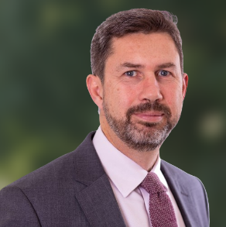
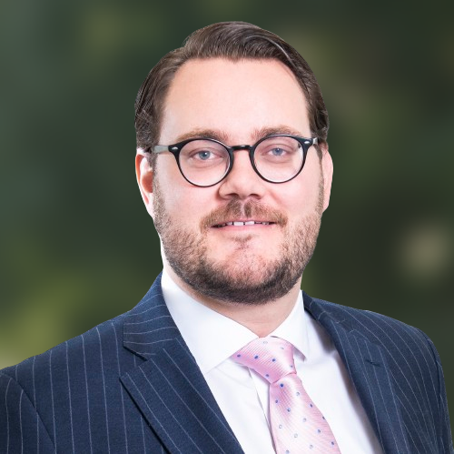
Interim Payment Applications for Property Claims
www.oldsquare.co.uk
Ben Collins KC
Carl Rix

Slide 41

Statutory Basis of Court’s Power
Section 32 Senior Courts Act 1981 / Section 50 County Courts Act 1984:
“provision may be made by rules of court for enabling the court, in such circumstances as may be prescribed, to make an order requiring a party to the proceedings to make an interim payment of such amount as may be specified in the order, with provision for the payment to be made to such other party to the proceedings as may be so specified or, if the order so provides, by paying it into court.” (subsection 1)
““interim payment”, in relation to a party to any proceedings, means a payment on account of any damages, debt or other sum (excluding any costs) which that party may be held liable to pay to or for the benefit of another party to the proceedings if a final judgment or order of the court in the proceedings is given or made in favour of that other party.” (subsection 5)

Slide 42
Basis for Interim Payment Under the CPR
Part 25 of the CPR has been revamped!
25.1.— Court's powers
(1) Interim remedies include—
(l) an order ('order for interim payment') under section V of this Part for payment by a defendant on account of any sum (except costs) which the court may hold the defendant liable to pay;

Slide 43
Court’s Power to Order Interim Payment (1)
25.20. Court's powers
(1) The court must not order an interim payment of more than a reasonable proportion of the likely amount of the final judgment.
(2) The court must take into account contributory negligence and any relevant set-off or counterclaim.
(3) The court may order an interim payment by instalments. If so, the order must set out—
(a) the total amount of the payment;
(b) the amount of each instalment;
(c) the number of instalments and the date on which each is to be paid; and
(d) to whom payment should be made.

Slide 44
Court’s Power to Order Interim Payment (2)
(4) Where a party seeks an interim payment and the court has ordered an account to be taken, if on the evidence the account is bound to result in a payment to the applicant, the court must, before making an order for interim payment, order that the liable party pay to the applicant the amount shown by the account to be due.
(5) The permission of the court must be obtained before making a voluntary interim payment in respect of a claim by a child or protected party. 'Child' and 'protected party' have the same meanings as in rule 21.1(2).
(6) The court may adjust any interim payment whether or not any payment has yet been made (voluntarily or under a previously made order). The court may in particular—
(a) order all or part of the interim payment to be repaid;
(b) vary or discharge the order for the interim payment;
(c) order a defendant to reimburse, either wholly or partly, another defendant who has `made an interim payment.

Slide 45
Court’s Power to Order Interim Payment (3)
(7) The court may make an order under paragraph (6)(c) only if—
(a) the defendant to be reimbursed has claimed against the other defendant for a contribution, indemnity or other remedy; and
(b) where the claim to which the interim payment relates has not been discontinued or disposed of, the circumstances are such that the court could make an interim payment order under this Section.
(8) Where a defendant has made an interim payment, and the amount of the payment is more than their total liability under the final judgment or order, the court may award them interest on the overpaid amount from the date when they made the interim payment.

Slide 46
CPR Basis for Applications (1)
25.21.— Applications
(1) The claimant may not apply for an interim payment order before the end of the period for filing an acknowledgment of service applicable to the defendant against whom the application is made.
(2) The claimant may make more than one application for an interim payment order.
(3) A copy of the application notice must be served at least 14 days before the hearing of the application and must be supported by evidence.
(4) If the respondent wishes to rely on written evidence at the hearing, they must file the written evidence and serve copies on every other party to the application at least 7 days before the hearing.

Slide 47
CPR Basis for Applications (2)
(5) If the applicant wishes to rely on written evidence in reply, they must file the written evidence and serve a copy on the respondent at least 3 days before the hearing.
(6) This rule does not require written evidence to be filed if it has already been filed, or to be served on a party on whom it has already been served.
(7) The court may make an order under this rule without an application by any party if it makes the order when it disposes of the claim or any part of it.

Slide 48
CPR Requirement on Evidence
25.22.— Evidence
An application for an interim payment order must be supported by evidence dealing with—
(a) the sum of money sought by way of an interim payment;
(b) the items or matters in respect of which the interim payment is sought;
(c) the sum of money for which final judgment is likely to be given;
(d) the reasons for believing that the conditions set out in rule 25.23 are satisfied;
(e) any other relevant matters;
(f) in claims for personal injuries, details of special damages and past and future loss; and
(g) in a claim under the Fatal Accidents Act 1976 , details of the person(s) on whose behalf the claim is made and the nature of the claim.
(2) Any documents in support of the application must be exhibited, including, in personal injuries claims, any medical report.

Slide 49
What is the legal test? What Needs to be satisfied? (1)
25.23 - The court may only make an interim payment order where any of the following conditions are satisfied—
the defendant against whom the order is sought has admitted liability to pay damages or another sum of money to the claimant;
the claimant has obtained judgment against that defendant for damages to be assessed, or for another sum of money (other than costs) to be assessed;
it is satisfied that, if the claim went to trial, the claimant would obtain judgment for a substantial amount of money (other than costs) against the defendant from whom they are seeking an interim payment, whether or not that defendant is the only defendant or one of several;

Slide 50
What is the legal test? What Needs to be satisfied? (2)
(e) the claimant is seeking an order for possession of land (whether or not any other order is also sought), and the court is satisfied that, if the case went to trial, the defendant would be held liable (even if the claim for possession fails) to pay the claimant a sum of money for the defendant's occupation and use of the land while the claim for possession was pending; or
(f) there are two or more defendants and the order is sought against any one or more of them, and—
(i) the court is satisfied that, if the claim went to trial, the claimant would obtain judgment for a substantial amount of money (other than costs) against at least one of the defendants (but the court cannot determine which); and
(ii) all the defendants are either public bodies; or insured in respect of the claim; or are defendants whose liability will be met by an insurer under section 151 of the Road Traffic Act 1988, or an insurer acting under the Motor Insurers Bureau Agreement, or the Motor Insurers Bureau where it is acting itself.

Slide 51
Relevance of CRU on Interim Payments
25.24.— Compensation recovery payments
Where in a claim for personal injuries there is a contested application for interim payment of damages, the defendant must obtain a certificate from the Secretary of State (as defined in rule 36.20(1)(e) ) where the claim—
falls under the heads of damage set out in column 1 of Schedule 2 to the Social Security (Recovery of Benefits) Act 1997 ('the 1997 Act') in respect of recoverable benefits received by the claimant set out in column 2 of that Schedule, or includes damages in respect of a disease for which a lump sum payment within the definition in section 1A(2) of the 1997 Act has been, or is likely to be made; and
(b) the defendant is liable to pay a recoverable amount (as defined in rule 36.20(1)(c) ) to the Secretary of State.
(2) A copy of the certificate must be filed at the hearing of the application.
(3) The order must set out the deductible amount (as defined in rule 36.20(1)(d) ).
(4) The payment made to the claimant must be the net amount but for the purpose of calculating the payment after the final judgment, the gross amount of the interim payment must be used.

Slide 52
Can the trial Judge know?
25.25. Restriction on disclosure
The fact that a defendant has made an interim payment, whether voluntarily or by court order, shall not be disclosed to the trial judge until all questions of liability and the amount of money to be awarded have been decided, unless that defendant agrees.

Slide 53
The Court’s Two-Stage Approach
The Court should consider the application in two stages: (See Schott Kem Ltd v Bentley [1991] 1 Q.B. 61, CA).
First the Court must be satisfied that the relevant criteria are met.
If so, the Court should then consider whether to exercise its discretion to order an interim payment.

Slide 54
Guidance From Smith v Bailey [2014] EWHC 2569 (QB) at [19] (1)
Helpfully summarises the key points from Eeles v Cobham Hire Services Ltd [2010] 1 WLR 409, CA
CPR r. 25.7(4) places a cap on the maximum amount which it is open to the Court to order by way of interim payment, being no more than a reasonable proportion of the likely amount of the final judgment (para 30).
In determining the likely amount of the final judgment, the Court should make its assessment on a conservative basis; having done so, the reasonable proportion awarded may be a high proportion of that figure (paras 37, 43).
This reflects the objective of an award of an interim payment, which is to ensure that the claimant is not kept out of money to which he is entitled, whilst avoiding any risk of an overpayment (para 43).
The likely amount of a final judgment is that which will be awarded as a capital sum, not the capitalised value of a periodical payment order ("PPO") (para 31).
The Court must be careful not to fetter the discretion of the trial judge to deal with future losses by way of periodical payments rather than a capital award (para 32).
The Court must also be careful not to establish a status quo in the claimant's way of life which might have the effect of inhibiting the trial judge's freedom of decision, a danger described in Campbell v Mylchreest as creating "an unlevel playing field" (paras 4, 39)

Slide 55
Guidance From Smith v Bailey [2014] EWHC 2569 (QB) at [19] (2)
(7) Accordingly the first stage is to make the assessment in relation to heads of loss which the trial judge is bound to award as a capital sum (para 36, 43), leaving out of account heads of future loss which the trial judge might wish to deal with by a PPO. These are, strictly speaking (para 43):
(a) general damages for pain, suffering and loss of amenity;
(b) past losses (taken at the predicted date of the trial rather than the interim payment hearing);
(c) interest on these sums.
(8) For this part of the process the Court need not normally have regard to what the claimant intends to do with the money. If he is of full age and capacity, he may spend it as he will; if not, expenditure will be controlled by the Court of Protection (para 44). Nevertheless if the use to which the interim payment is to be put would or might have the effect of inhibiting the trial judge's freedom of decision by creating an unlevel playing field, that remains a relevant consideration (para 4). It is not, however, a conclusive consideration: it is a factor in the discretion, and may be outweighed by the consideration that the Claimant is free to spend his damages awarded at trial as he wishes, and the amount here being considered is simply payment at the earliest reasonable opportunity of damages to which the Claimant is entitled: Campbell v Mylchreest [1999] PIQR Q17.
(9) The Court may in addition include elements of future loss in its assessment of the likely amount of the final judgment if but only if (a) it has a high degree of confidence that the trial judge will award them by way of a capital sum, and (b) there is a real need for the interim payment requested in advance of trial (para 38, 45).
(10) Accommodation costs are "usually" to be included within the assessment at stage one because it is "very common indeed" for accommodation costs to be awarded as a lump sum, even including those elements which relate to future running costs (paras 36, 43).

Slide 56
Importance of Defendant’s Adducing Evidence
It is for the Defendant to adduce evidence of contributory negligence at the application. The Court is entitled to proceed on the basis of full liability where there is no such evidence. (Smith v Bailey [2014] EWHC 2569 (QB)
If the Defendant does not adduce its own expert evidence at the application hearing, then the Court will proceed on the basis of the evidence before it. (Sellar-Elliott v Howling [2016] EWHC 443 (QB))

Slide 57
What is a ‘Reasonable Proportion’?
There is no judicial guidance on what is “a reasonable proportion”, nor should there be as the matter is one for the judge’s discretion (Dolman v Rowe [2005] EWCA Civ 715).
The Court has to do his best to make a rough estimate of the likely award and in doing so is entitled to bring into account its general experience.
In TTT v Kingston Hospital NHS Trust [2011] EWHC 3917, QB, a clinical negligence claim, the Court stated that the case law supported the award of an interim payment of 90% of a conservative assessment of the likely value of the capital sum.

Slide 58
Some practical issues When to make the application?
The starting point: What are the claimant’s needs?
Nature of the accommodation:
Single storey
Wheelchair accessibility
Entrances and exits
Need for external carers/therapists
But this is litigation, so you must also bear in mind: Will an application succeed?
That means: Can you satisfy the Eeles requirements?

Slide 59
Eeles 1
The judge’s first task is to assess the likely amount of the final judgment, leaving out of account the heads of future loss which the trial judge might wish to deal with by PPO. Strictly speaking, the assessment should comprise only special damages to date and damages for pain, suffering and loss of amenity, with interest on both. However, we consider that the practice of awarding accommodation costs (including future running costs) as a lump sum is sufficiently well established that it will usually be appropriate to include accommodation costs in the expected capital award. The assessment should be carried out on a conservative basis. Save in the circumstances discussed below, the interim payment will be a reasonable proportion of that assessment. A reasonable proportion may well be a high proportion, provided that the assessment has been conservative. The objective is not to keep the claimant out of his money but to avoid any risk of over-payment.
For this part of the process, the judge need have no regard as to what the claimant intends to do with the money. If he is of full age and capacity, he may spend it as he will; if not, expenditure will be controlled by the Court of Protection

Slide 60
Eeles 1
Does the Eeles 1 calculation give you enough?
NB Yip J in PAL v Davison [2021] EWHC 1108 (QB):
It may be possible to include damages which have not yet accrued but which may have done so (on a conservative basis) by the time of trial.
See e.g. loss of earnings, gratuitous care.
What about care/therapy costs? That may be more difficult.
Also bear in mind that, “The longer the estimated period to trial, the greater the uncertainty and so the greater the risk.”

Slide 61
Eeles 2
“We turn to the circumstances in which the judge will be entitled to include in his assessment of the likely amount of the final judgment additional elements of future loss. That can be done when the judge can confidently predict that the trial judge will wish to award a larger capital sum than that covered by general and special damages, interest and accommodation costs alone...
Before taking such a course, the judge must be satisfied by evidence that there is a real need for the interim payment requested. For example, where the request is for money to buy a house, he must be satisfied that there is a real need for accommodation now (as opposed to after the trial) and that the amount of money requested is reasonable. He does not need to decide whether the particular house proposed is suitable; that is a matter for the Court of Protection. But the judge must not make an interim payment order without first deciding whether expenditure of approximately the amount he proposes to award is reasonably necessary. If the judge is satisfied of that, to a high degree of confidence, then he will be justified in predicting that the trial judge would take that course and he will be justified in assessing the likely amount of the final award at such a level as will permit the making of the necessary interim award.”

Slide 62
The evidence
If you are relying only on the Eeles 1 calculation, the only evidence needed is enough to support the value of the claims for PSLA, loss of earnings, gratuitous care (and perhaps additional claims as per PAL).
Are there reports that can be disclosed as they are?
If not, shorter reports directed only at the application.
Bear in mind that there is no need to show what the money will be used for – only that it does not exceed a reasonable proportion of these heads of loss.

Slide 63
The evidence
If you are relying on an Eeles 2 calculation, the position is more complex.
Factual evidence
Witness statements from family; case manager; ?therapists.
Notes and reports of ongoing e.g. MDT meetings.
Expert evidence
Think about what you need to prove: Whose evidence will be needed? Accommodation, but:
Care? Therapy?

Slide 64
The evidence
Accommodation evidence
The basics: To review the Claimant’s immediate / short-term needs.
To satisfy the court that “there is a real need for accommodation now (as opposed to after the trial)”.
To identify the requirements for a property.
To identify a reasonable valuation for a property of that sort in the appropriate location.
?Evidence as to what the appropriate location is?

Slide 65
The property
Has a specific property been identified?
Not necessary, but may add focus to the application.
Is there likely to be a dispute as to the valuation of the property?
Size
Location
Facilities
Purchase or rental?

Slide 66
Final thoughts
The more compelling the evidence, and the more detailed the preliminary schedule of loss, the easier to reach agreement.
Is it worth having a RTM?
What is the real battle?
In many cases – the valuation of the care regime.
If the property enables you to put in place the care regime you will argue for, that inevitably strengthens the care claim at trial by showing it works.
That may strengthen the defendant’s resolve to fight – hence the need for the best possible preparation.

Slide 67



Thank you
Contact
London
10 - 11 Bedford Row
London WC1R 4BU
DX 1046 London / Chancery Lane
T 020 7269 0300
Bristol
5th Floor
One Temple Quay
Temple Back East
Bristol BS1 6DZ
E clerks@oldsquare.co.uk
W oldsquare.co.uk
Old Square Chambers
@oldsquarechambers.bsky.social

Slide 68

Our Professional Values and Behaviours
22 January 2026

Slide 69

Objectives
A shared understanding of our core professional values
Clear expectations of behaviours colleagues can rely on
Technical excellence sets the standard but it is our shared values, our character and how we live them every day that defines who we are – a team I am incredibly proud to lead. That is what makes us “Tees”.

Slide 70

Our Ecosystem
Professional obligations
Business imperatives
Reputational considerations
Each other
What are the firm values?
What are the Tees rules?
How does our department contribute to the wider firm?
What does the firm expect from us?
What do we expect from each other?
Notes:
0-10min

Slide 71
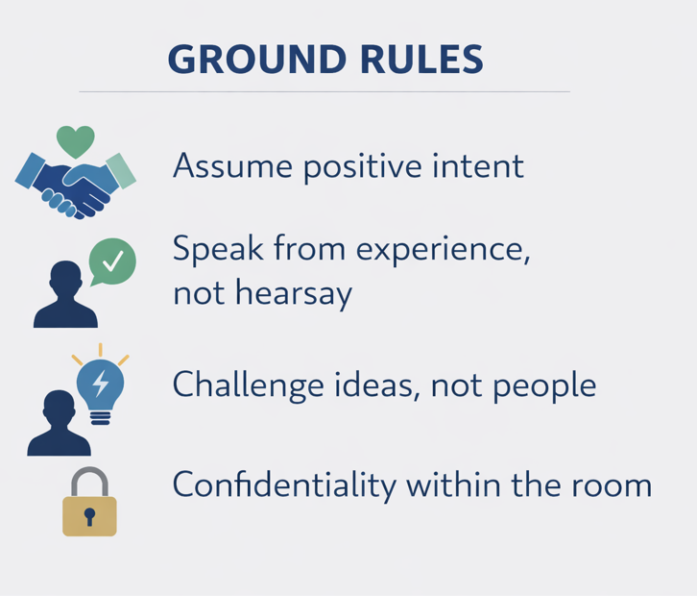
Discuss in pairs:
“Do professional values and expected behaviours matter? If so, why?”
Shared values and clear behavioural expectations underpin consistent standards of practice, promote trust and collaboration, reduce risk, and support colleagues working in a demanding and emotionally challenging environment, ultimately enabling the team to deliver fair, ethical, and high-quality outcomes for clients and the firm.
When have we been at our best as a team?
What behaviours were present?
What wasn’t happening at those times?
Notes:
10-15 min

Slide 72
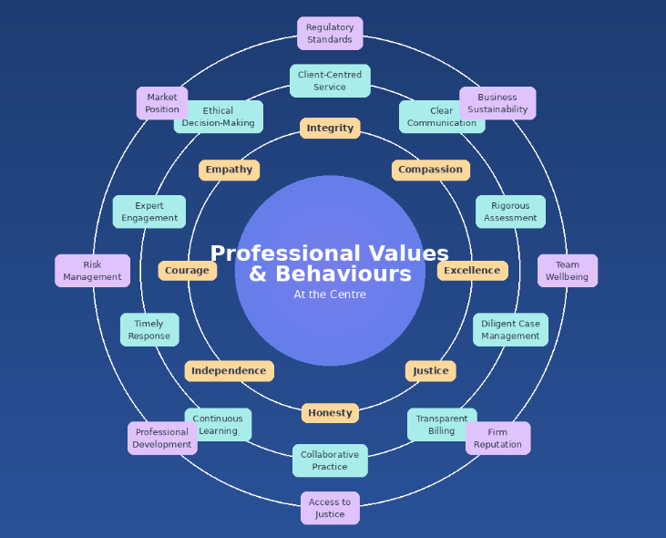

Core professional values
Discuss in pairs:
What are our values?
Which values do we already live really well?
Which ones are hardest?
Notes:
15-20min

Slide 73
Core professional values
Client-centred integrity
Excellence, rigour and judgement
Accountability – to clients, colleagues and the business
Collaboration and respect
Commercial awareness and sustainability
Compassion and professionalism
Continuous learning and improvement
Discuss one these in groups of 3-4.
What does one of these look like in practice?
What undermines it when pressure is high?
Notes:
20-30min
Safe does not equal soft
Challenge does not equal disrespectful

Slide 74
Core professional values
Client-centred integrity
We act honestly, ethically and in our client’s best interests at all times. We give clear advice about prospects, risk, cost and timescale. We manage expectations responsibly. We recognize that sustainable client relationships depend on trust and transparence and that integrity underpins both client outcomes and the long-term reputation of the department.
Excellence and rigour
We take pride in the quality of our work. We approach cases with care, discipline, attention to detail, and intellectual rigour. We exercise sound professional judgement about which cases to pursue and how and we recognise that quality decision-making protects clients and the business. Excellence is essential to credibility, efficiency and profitability.
Accountability – to clients, colleagues and the business
We take responsibility for our work, our decisions and their impact. This includes accountability for case strategy and progress, costs, risk and proportionality and the effective use of time and resources. We recognize that individual decisions affect team performance and commercial outcomes. When things go wrong, we focus on early disclosure, learning and solutions – not blame or defensiveness.
Collaboration with respect
Medical negligence work is a team business. We value the contribution of every role, we share knowledge and experience openly. We share responsibility. We work constructively with and treat colleagues, experts, opponents and the court with professionalism and respect. Collaboration improves quality, reduces risk, and supports sustainable growth.
Notes:
30-35min

Slide 75
Core professional values
Compassion (for clients and colleagues)
We recognise the emotional impact of this work on clients and colleagues. We act with empathy, maintain professional boundaries, and support one another through challenging cases.
Commercial awareness and sustainability
We recognise that we are responsible not only for being good lawyers, but also for being good stewards of the department.
We understand how our work contributes to the financial health of the department, we manage cases proportionality, efficiently and strategically. We recognize the importance of billing discipline, recovery and cost control. We support business development, reputation and long-term growth. Commercial awareness is part of professionalism, not separate from it.
Continuous learning
We commit to developing our legal, medical and professional skills. We reflect on outcomes, learn from successes and setbacks, welcome feedback and support each other’s growth. Continuous improvement strengthens both client outcomes and business resilience.
Notes:
30-35min

Slide 76
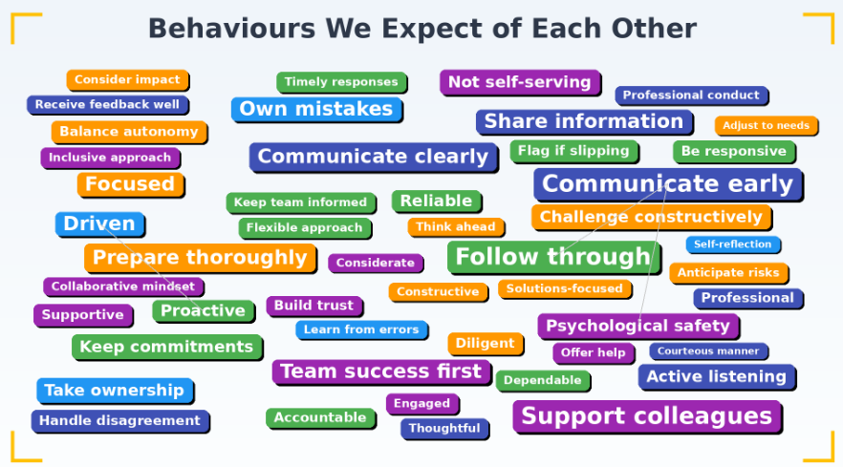
Behaviours - how we treat clients, how we treat each other and how we run the department
In groups of 3-4:
What are behaviours do we expect?
Notes:
35-40min

Slide 77


Notes:
Apollo 13 tells the true story of a 1970 NASA mission that was meant to land on the Moon but turns into a life-or-death rescue after an onboard oxygen tank explodes. Astronauts Jim Lovell, Jack Swigert, and Fred Haise are left with a crippled spacecraft and limited power, air, and water. Working together with mission control in Houston, they improvise solutions to overcome multiple technical failures and bring the crew safely back to Earth, turning a failed mission into a triumph of teamwork and ingenuity.
In Apollo 13, the problems are solved in roughly this order:
Immediate survival after the explosion – The crew realizes the oxygen tank has exploded and must shut down the command module to conserve power.
Finding a way to breathe – They move into the lunar module and use it as a “lifeboat” to provide oxygen and power.
Restoring navigation and course – With damaged systems, they perform manual burns to get the spacecraft back on a safe trajectory toward Earth.
Managing limited resources – They deal with severe shortages of electricity, water, and heat to keep the crew alive.
Removing carbon dioxide buildup – Engineers on Earth design a way to fit square command-module filters into round lunar-module systems.
Safe re-entry planning – Near Earth, they power the command module back up and prepare it to survive re-entry and land safely.

Slide 79
Behaviours we expect of each other
Being “all-in”
Assuming positive intent
Psychological safety
Respectful candour –
Collective ownership
Boundaries and well-being
Constructive challenge
Discuss one of these in groups of 3-4.
What does one of these look like in practice?
What undermines it when pressure is high?
Notes:
50-60min

Slide 80
Behaviours we expect of each other
Being all in
We are engaged, prepared and committed. We are contributors not passengers. This means taking ownership of cases and outcomes, following issues through and understanding the wider impact of our work on the team and business. Being “all in” means responsibility, contribution and engagement – not unsustainable overwork.
Assuming positive intent
We assume colleagues are acting in good faith. We seek understanding - curiosity before judgement. We address issues directly and constructively and avoid blame, gossip or cynicism.
Psychological safety
We create a safe environment to ask questions, raise concerns or uncertainties, flag risks, mistakes or inefficiencies early and to challenge decisions respectfully. Speaking up early protects clients, colleagues and the business.
Boundaries and Wellbeing
High performance must be sustainable. We are open about capacity and pressure. We respect reasonable boundaries. We support each other to work effectively over the long term. Commitment without burnout.
Constructive challenge
We challenge ideas, strategies and assumptions in client’s and firm’s best interests. Challenge is expected, respectful and independent of seniority. Strong challenge leads to better outcomes and better use of resources.
Respectful communication and candour
We communicate clearly, honestly, directly and professionally. We give and receive feedback constructively, raise difficult issues directly and avoid avoidance or passive behaviour.
Collective ownership
We share responsibility for client outcomes, risk management, financial performance and the reputation of the department. Successes and setbacks belong to the team, not individuals.
Notes:
60-70min
In the film, a technician notices a potential problem with the oxygen tank during ground testing. However, the concern is minimized and not fully escalated through the chain of command. The culture at the time emphasized schedules, hierarchy, and confidence in systems, which made it difficult for individuals to push back strongly or stop the launch. As a result, a warning sign was effectively dismissed rather than openly debated.
This scene is often used as a lesson in psychological safety: when people don’t feel empowered to speak up—or believe they won’t be listened to—small concerns can turn into major failures.

Slide 81
Behaviours That Integrate Professional Values and Business Excellence Some examples…
Rigorous case assessment (professional integrity) also prevents costly unprofitable files (business efficiency)
Clear client communication (professional duty) also reduces complaints and reputational risk (business protection)
Investing in expertise (professional excellence) also builds competitive advantage (business grown)
Honest reporting about poor prospects (professional honesty) also preserves firm resources for meritorious claims (business sustainability)
Supporting junior staff development (professional responsibility) also improves retention and reduces recruitment costs (business efficiency)
Notes:
70-75min

Slide 82
So what?
Notes:
Personal ownership of one professional value, one behaviour
Pledge to each other?

